Slide 1
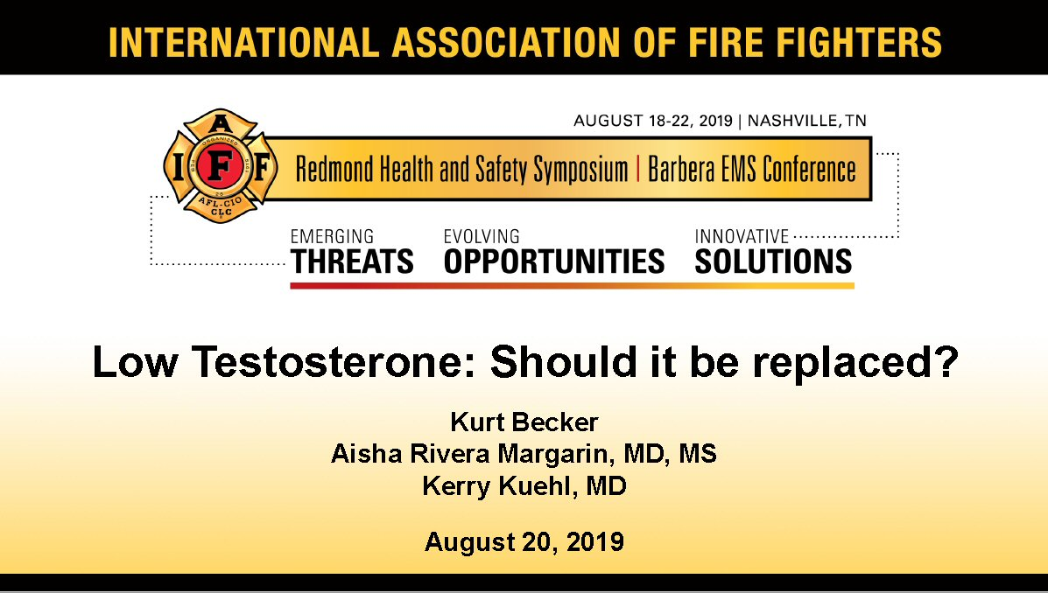

Slide 2
Outline
Scope of problem
Concern at the firehouse
Causes
Diagnoses
Treatment
Management
Mitigation strategies
Question and answers

Slide 3
Scope of the Problem
Testosterone Deficiency in Fire Fighters

Slide 4
What is Testosterone Deficiency?
Symptoms:
Reduced libido
Difficulty obtaining or maintaining an erection
Difficulty concentrating or making decisions
Poor results from exercise programs
Increase in body fat
Loss of lean body (muscle) mass
Loss of bone density
Depression
Poor work performance
Unfavorable changes in cholesterol profile

Slide 5
What is Testosterone Deficiency?
Health Effects of Low-Testosterone
Beyond the symptoms that many men experience, testosterone deficiency syndrome can also contribute to the onset or worsening of various diseases: Increased risk of cardiovascular disease; Increased risk of death from a cardiovascular event; Increased risk of metabolic syndrome: high blood pressure, elevated insulin levels, excess belly fat and abnormal cholesterol levels; Strong association with diabetes; Strong association with atherosclerotic disease of the aorta; Higher incidence of prostate cancer; Association with more aggressive variants of cancer.

Slide 6
What Are Normal Testosterone Ranges?
In general, the normal range in males is about 270-1070 ng/dLwith an average level of 679 ng/dL.
A normal male’s testosterone level peaks at about age 20, and then it slowly declines about 1% per year thereafter.
Some researchers suggest that the healthiest men have testosterone levels between 400-600 ng/dL.
The American Urological Association suggests that clinicians should use a total testosterone level below 300 ng/dLas a reasonable cut-off in support of the diagnosis of low testosterone.
The Endocrine Society has published that the harmonized normal range for testosterone in a non-obese population of European and American Men, 19-39 years, is 264-916 ng/dL.

Slide 7
Significant Increase in TRT in Fire Fighters
Over the last decade prescribed testosterone use, or TRT, has increased markedly amongst Fire Fighters, with some major metropolitan fire departments reporting 25% of employees on TRT.
In population-based studies, the prevalence of testosterone deficiency in men aged 47-60 years ranges from2.1% to 12.8%.The operational definition of testosterone deficiency used across studies varies considerably.
The prevalence of testosterone deficiency in obese patients was found to be57.7%and35.6%, using the cut-offs TT <317 ng/dL and FT <78 pg/ml, respectively. Another study using the cut-offs TT < 300 ng/dl or FT < 65 pg/ml found the prevalence in obese patients to be78.8% and 51.5%, respectively.
The prevalence of testosterone deficiency in patients with the metabolic syndrome ranges from 30 to 35%.
Systematic Literature Review of the Epidemiology of Non-Genetic Forms of Hypogonadism in Adult Males. Victoria Zarotsky, Ming-Yi Huang, Wendy Carman, Abraham Morgentaler, Puneet Singhal, Donna Coffin, and T. H. Jones, Journal of Hormones 2014

Slide 8
Fire Fighter Career Progression

Slide 9
Is Obesity Why So Many Fire Fighters Have Low-T?
While obesity and metabolic syndrome are significant problems in the fire service, and it is clear that obesity is a primary cause of Low-T, there are numerous other primary and secondary causes of Low-T effecting Fire Fighters:
Sleep disturbance
Normal Aging
Opioid Use
Alcohol Use
Lack of Exercise

Slide 10
Causal vs Correlation
Does Fire Fighting Cause Low-T?
A correlation is a measure or degree of relationship between two variables. A set of data can be positively correlated, negatively correlated or not correlated at all. As one set of values increases the other set tends to increase then it is called a positive correlation.
A causal relation between two events exists if the occurrence of the first causes the other. The first event is called the cause and the second event is called the effect.
A correlation between two variables does not imply causation. On the other hand, if there is a causal relationship between two variables, they must be correlated.
At this time there is not evidence to support the argument that there is a causal relationship between fire fighting and Low-T.

Slide 11
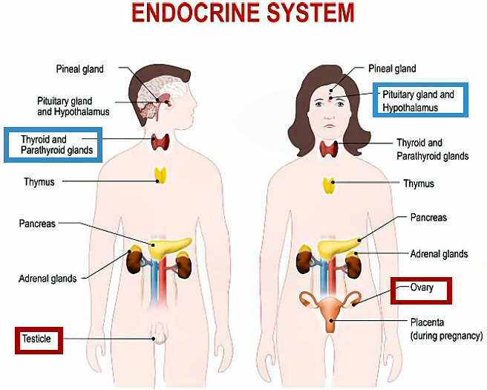
Causes of Testosterone Deficiency

Slide 12
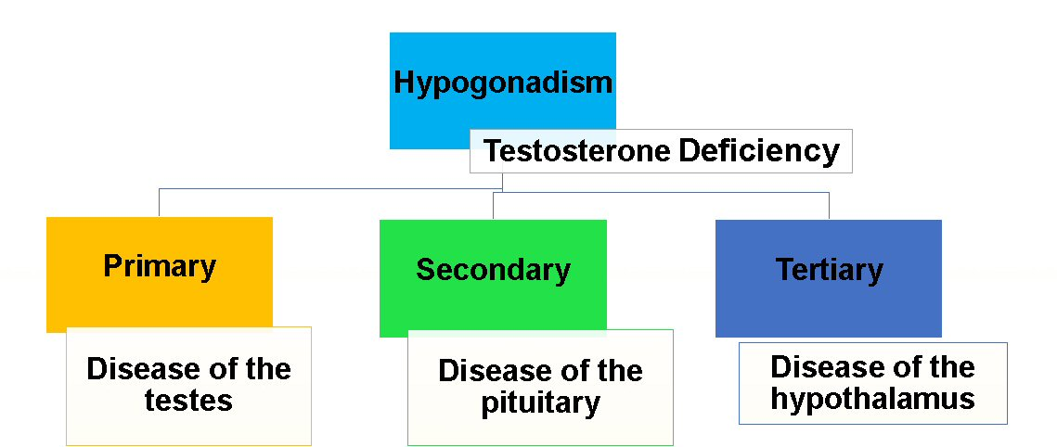
Causes of Testosterone Deficiency

Slide 13
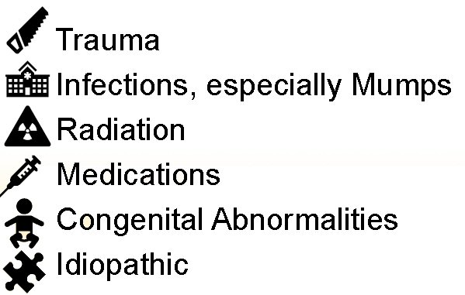
Causes of Testosterone Deficiency
Primary Hypogonadism
Clinical Features and Diagnosis of Male Hypogonadism.” UpToDate, www.uptodate.com
Image source: https://ui-ex.com/explore/gonads-clipart-anatomy/

Slide 14
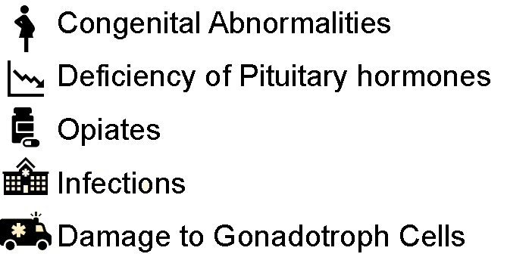
Causes of Testosterone Deficiency
Secondary Hypogonadism
Clinical Features and Diagnosis of Male Hypogonadism.” UpToDate, www.uptodate.com
Image source: https://ui-ex.com/explore/gonads-clipart-anatomy/

Slide 15
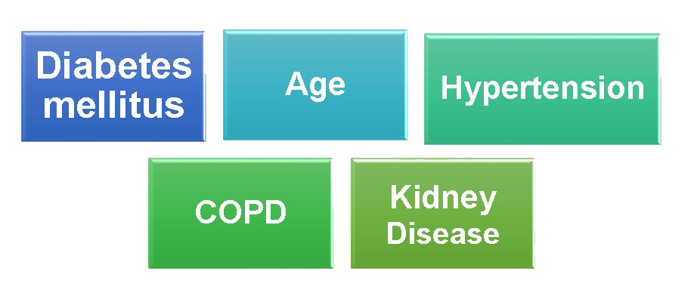
Causes of Testosterone Deficiency
Miscellaneous Contributors

Slide 16
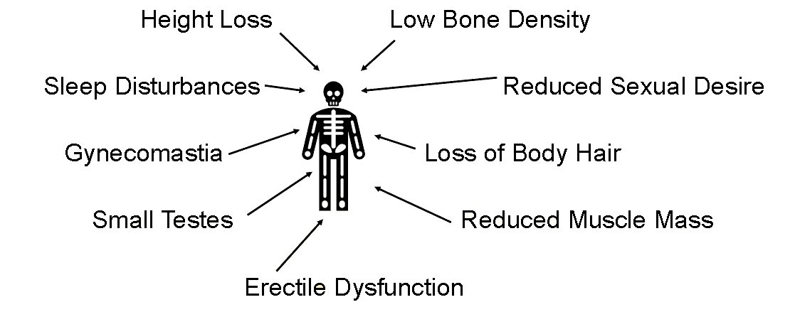
Signs and Symptoms

Slide 17
Case Scenario
What is the Possible Diagnosis?
A 65 year-old man is evaluated for fatigue, weakness, and erectile dysfunction, which have been progressing over the last few years. He describes disrupted sleep, waking up approximately two to three times per night.
On his physical examination is blood pressure and vital signs were normal. Visual fields are full to confrontation. Testes are normal size and without masses.
In this case, we should immediately rule out: Low Testosterone

Slide 18
Alternative Diagnoses
Depression
Hypothyroidism
Pituitary Lesions
Adrenal Tumor
Drugs
Malnutrition
Prolactinoma

Slide 19
Evaluation and Diagnosis
As suggested by the Endocrine Society Guidelines, physicians should check testosterone levels when the prevalence is high and symptoms are present.
Situations in which the prevalence is high____________________
Medications that affect testosterone production
Infertility
Type 2 Diabetes
End Stage Renal Disease
Osteoporosis

Slide 20
Additional Diagnostic Considerations
Measurement of the serum testosterone concentration is usually the most important single test
The normal range in adult men in most laboratories is approximately 300 to 800 ng/dL
Measurement of the serum free testosterone concentration is worthwhile in certain situations
Two common situations of abnormal testosterone binding may occur 1) obesity and 2) aging

Slide 21
Additional Diagnostic Considerations
Fire Fighters seeking testosterone screenings should:
Contact an Endocrinologist or a Urologist specializing in the diagnosis and treatment of Low-T
DO NOT go to a “men’s clinic”
Labs must be drawn first thing in the morning, after fasting for 12 hours, and after a full night of sleep
If low levels are found, a repeat test should be done under the same conditions 2-3 weeks later
2 separate tests are required for an accurate diagnosis

Slide 22
Case Scenario
A 41 y/o male firefighter (12 year career) works at busy station (24-48 shift) complains of one year of increased fatigue, weight gain, poor sleep. Past Medical History includes: Hypertension, Prediabetes (HgA1C 5.9), Bbstructive Sleep Apnea, Low HDL-cholesterol, his BMI is 31. NFPA 1582 EKG Stress Test is normal. VO2Max = 38 ml/kg/min. He drinks 2 beers per night off shift at home.
• Other labs normal including thyroid, but Total Testosterone Level of
265 ng/dl
• Diagnosis: Metabolic Syndrome with Low Testosterone
• Doctor wants to place patient on Androgel
What are options and what is best next step?

Slide 23
Lifestyle Factors
What are preventable reasons for low T?
Sleep deprivation
Excessive exercise/overtraining
Obesity
Work demands/stress
Alcohol
Marijuana
Hirokawa K, Taniguchi T, FujiiY, et al. Modification Effects of Changes in Job Demands on Associations Between Changes in Testosterone Levels and AndropauseSymptoms: 2-Year Follow-up Study in Male Middle-Aged Japanese Workers. In J BehMed. 2016;23:464–472

Slide 24
Lifestyle Factors
What functional reasons for low T?
Some low T levels are considered “functional” meaning that they are due to another cause rather than the T hormonal pathway.
Medications such as opioids, anabolic steroids and prohormones (Andro, DHEA, etc)
Nutritional deficiency
Obstructive sleep apnea
Chronic illness
Overweight: According to a Harvard Men's Health Watch article, a five-point increase in body mass index (e.g., from 30 to 35) lowers Testosterone levels as much as 10 years of aging.
Harvard Men's Health Watch. https://www.health.harvard.edu/mens-health/a-new-look-at-testosterone-therapy. May, 2016 (accessed 4/13/2019)

Slide 25
Mitigation Strategies
Establishment of positive sleep hygiene and consideration of referral for assessment of sleep apnea signs and symptoms;
Referral to clinicians trained to treat the specific behavioral health concerns of the warrior culture occupation community;
Referral to endocrine or urology specialist to diagnose and treat as needed the presence of testosterone deficiency;
Establishment of diet and exercise regime geared toward the reduction of body fat and increase in muscle mass and cardiovascular fitness.

Slide 26
Medication Use
An oral form of Testosterone was approved by the US Food and Drug Administration in March 2019. (https://www.fda.gov/news-events/press-announcements/fda-approves-new-oral-testosterone-capsule-treatment-men-certain-forms-hypogonadism)
After starting therapy, follow-up with your physician periodically to have T levels and other lab tests checked to make sure the therapy is not causing any problems with your prostate or blood chemistry. Monitoring hematocrit is especially important for fire fighters.

Slide 27
Caution on Gels
Users of AndroGel are advised to avoid “fire, flames, or smoking” until the gel has dried since they are alcohol-based.
Avoid showering for at least 5 hours after application (counter to some decon procedures promoted for cancer prevention).
If taking this medication, firefighters should not apply product within 5 hours of a shift that require fire suppression activities.

Slide 28
Treatment
Fire Fighters diagnosed with Low-T must implement lifestyle changes before, or in addition to TRT:
Dedicated exercise regime
Dedicated diet and weight loss plan
Establishment of consistent sleep hygiene
Relationship with licensed behavioral health professional specializing in warrior culture issues and treatment
Smoking/tobacco cessation
Decrease alcohol consumption

Slide 29
Take Home Points
If you have potentially reversible causes of low testosterone levels, should first be treated with lifestyle modification and avoid the need for T supplementation.
Avoid clinics that market to men and focus only on non-specific symptoms. Avoid clinics that don’t follow the T measurement criteria discussed. If found to have low T, get a second opinion from an endocrinologist.
Specifically, to prevent low testosterone in light of the inherent risk factors of low testosterone associated working as a firefighter, establish positive lifestyle practices such as a regular exercise regime (including cardiovascular exercise and strength training), a healthy diet, a plan for improving sleep, achieve optimal body weight, and implement a daily stress management plan and activity.

Slide 30
Resources
The Endocrine Society has published guidelines of specific conditions in which T should not be prescribed. These include men planning to procreate, men with breast or metastatic prostate cancer or PSA test results above specific levels and other reasons.
US FDA: Androgen testing and replacement
If need further information: kuehlk@ohsu.edu, IAFF@ rdoctor@iaff.org

Slide 31
Lifestyle Factors Published References
Kumagaiet al (2015) 12-wk lifestyle modification program involving aerobic exercise and diet modification significantly increased testosterone levels.
Heufelder et al (2009) 52-wk program of diet and exercise significantly increased mean serum testosterone levels.
Camacho et al (2013) Individuals who lost 10% of weight between visits showed a significant increase in testosterone levels.
Corona et al (2013) Weight loss through low-calorie diets or bariatric surgery was associated with significant increases in total testosterone levels.
Santamaria et al (1998) Significant improvement in sleep among men with OSA who were treated had significant increases in testosterone level at 3 months.
Leproult and Van Cauter(2011) Restriction of sleep to 5 h/night decreased testosterone levels by 15%.
Sexual Medicine Reviews 2018

Slide 32
Lifestyle Factors Published References
Singer and Zumoff(1992) Men with high stress levels had significantly lower serum testosterone levels compared to control subjects (men with low or normal stress)
Guay et al (2010) Men with higher work stress had higher than expected incidence of hypogonadism
Su et al (1995) Varicocele surgery significantly increased mean testosterone levels
Tanrikut et al (2011) Varicocele repair significantly increased testosterone levels
Sathya Srini and Belur, Veerachari(2011). Significantly increased total testosterone levels were found at 12-mo follow-up after varicocelectomy
Li et al 2012 Mean serum total testosterone significantly increased after varicocelectomy
Hiroshi Kumagaiet al (2016) Increased physical activity has a greater effect than reduced energy intake on lifestyle modification-induced increases in testosterone
Sexual Medicine Reviews 2018

